Slide 1

Information system
Group members:
Syed Hamza Hoda 20b-124-cs
Abdur Rafay 20b-125-cs

Slide 2

Problem Statement:
Dada Bhai Noorejee Electronics, an electronic parts distributor, wants to develop an inventory and sales reporting system for month-based statistics of sales (Area wise and part-wise). A Microsoft Access database of parts inventory and sales record already exists. The system should include a splash screen, employee login, unique employee IDs, and the ability to print sales reports containing product ID, description, quantity sold, sales price, and extended price. Salespeople should also be able to view total number of orders, total items sold, and total annual sales in Pak rupees and US dollars. Any relevant tools and techniques may be used to create the system.

Slide 3

Our Approach:
Dada Bhai Noorejee Electronics requires an information system to manage orders, inventory, and produce reports on a monthly basis, in accordance with the problem description above. To complete these objectives, we created a web application. Our app has many forms for the various functionality listed in the problem description. Moreover we have also build graphs in the dashboard section to let the user have a quick idea about the business

Slide 4

Tech stack
These are the technologies that we’ve used to build our project
HTML,
CSS,
JS,
React,
Firebase,
Bootstrap

Slide 5

Now let’s have a look at out web app 😇

Slide 6
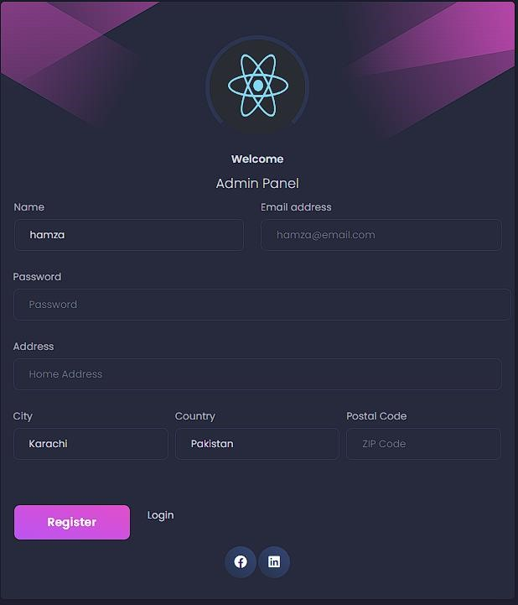
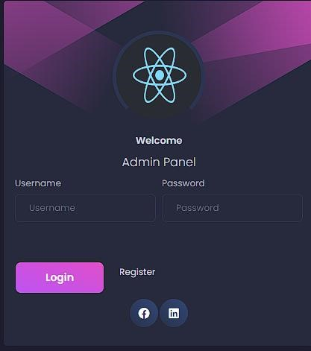

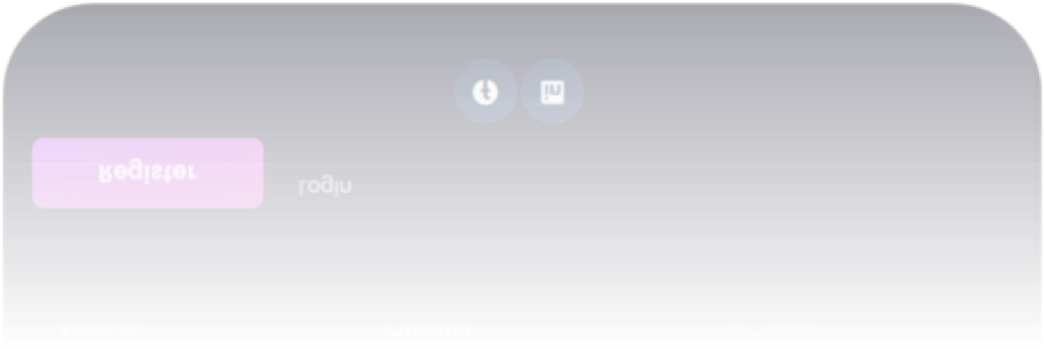
Login/Register form
At first when a user visits our website
they will be greeted with login form A
registered user have to login with his/her
credentials while a new user has to
register by clicking on the register
button and filling the form, once
registration is complete the
credentials are stored in the database

Slide 7

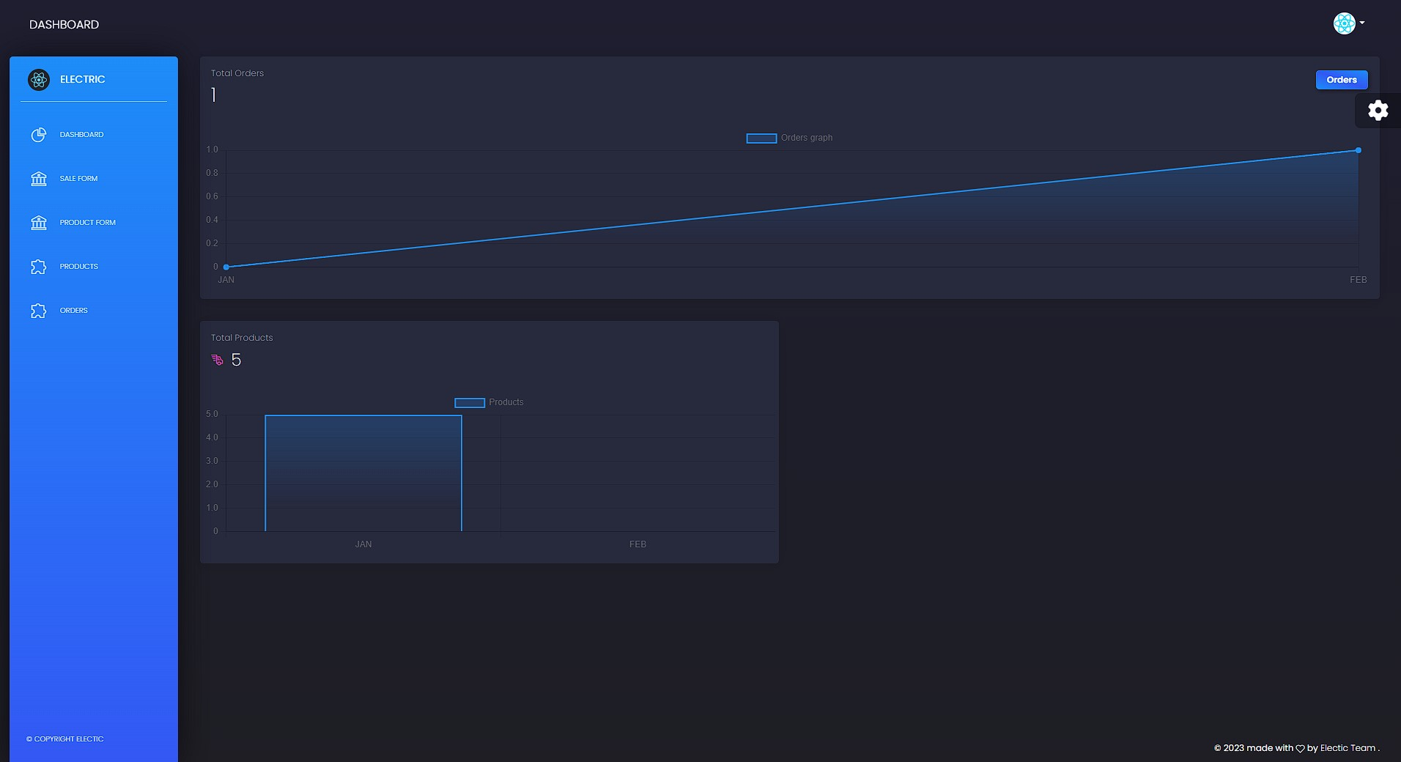
DASHBOARD
Once logged-in, the very first interface
will be dashboard screen, here a user
can view the product graph as well as
order graph, making it easy for the
user to get insights It also shows
the number of orders and the number of
products availaible

Slide 8

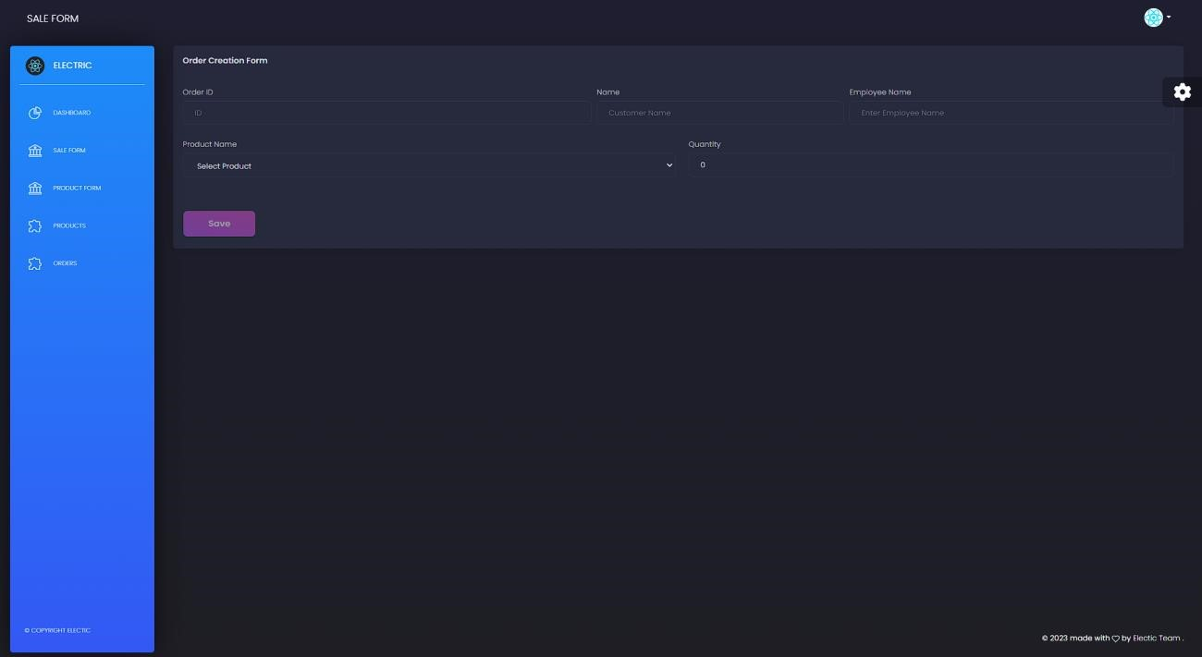
SALE FORM
Next page is the sale form here
a user can create order, by
filling out the form. Every
salesperson have an unique id
which is required in this form so
that commission can be
calculated for each salesperson.
One the order is created it is
stored in the database.

Slide 9

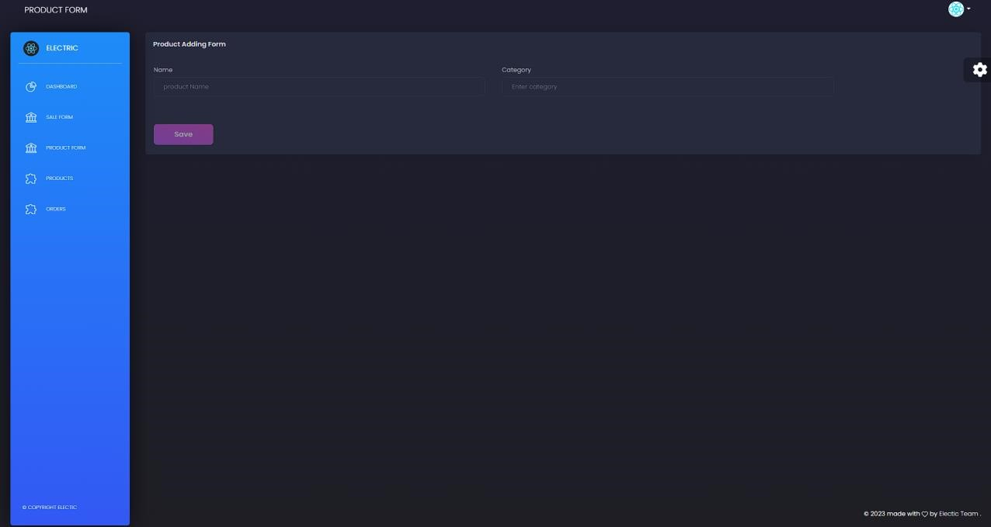
PRODUCT FORM
Third form is the product form,
This form adds a new product to the
database. Each product requires to
have a category.

Slide 10

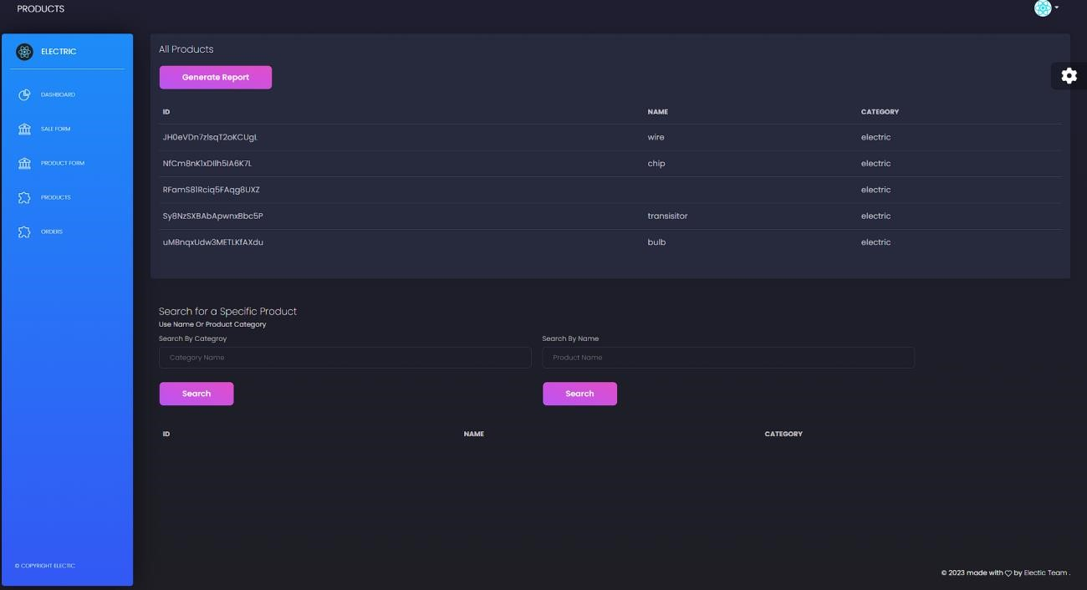
PRODUCTS
Fourth screen is product screen
here a user can view all the
products in a database, also a
user can filter out the products
based on category and also
search for a specific product

Slide 11
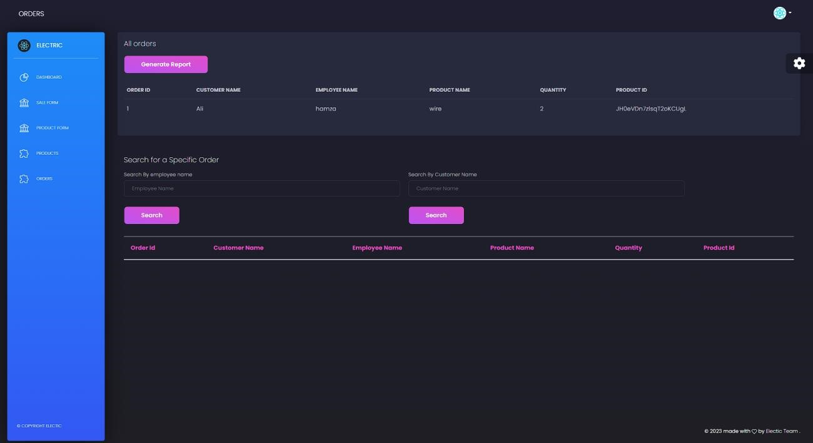
ORDERS
The last screen is the orders
screen, it is a record of all
the order history. The table
consists of following columns
Order id
Customer name
Employee name product name
Quantity
Product id
Orders can also be searched
by employee name or customer
name

Slide 12

Thank you

